Slide 1

VISUALLY IMPAIRED

Slide 2
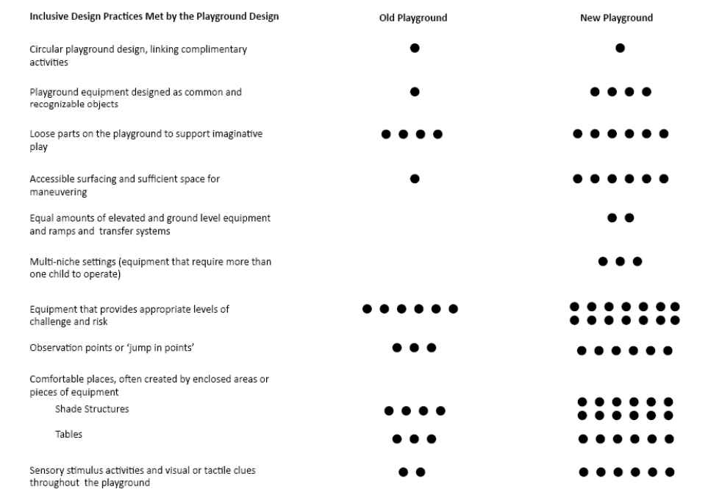

Slide 3
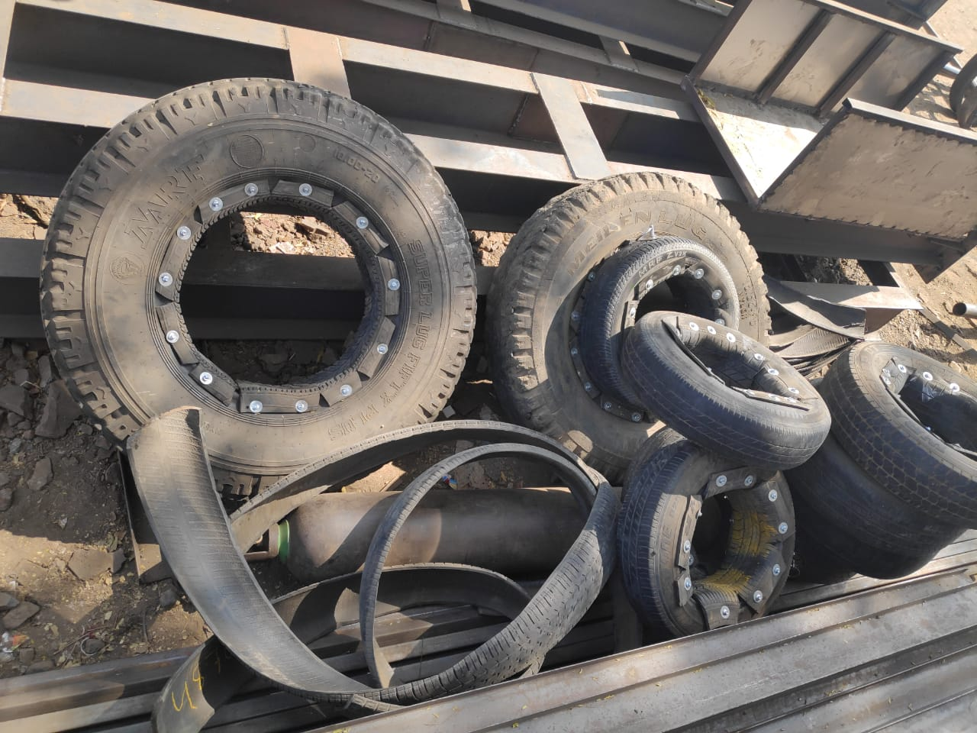
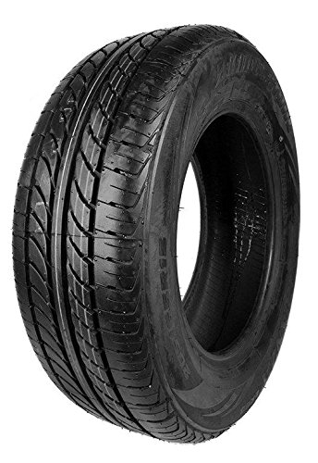
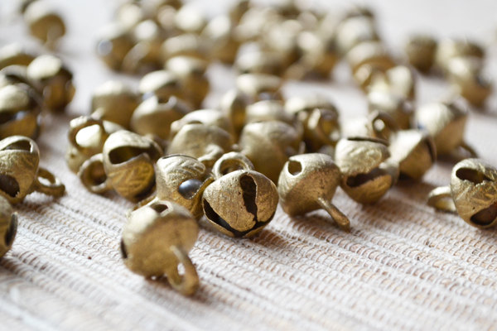
the concept of soundful tyres
+
+
=
A full tyre + cut tyres + Any sound making devices
packing a tyre in this manner

Slide 4
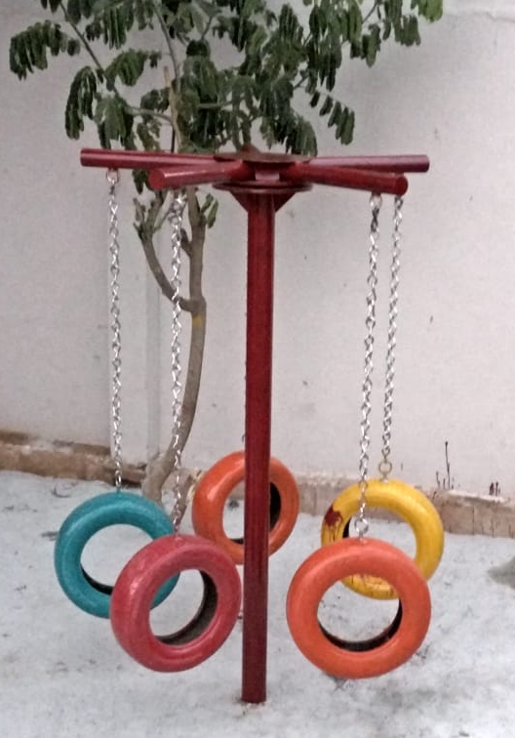
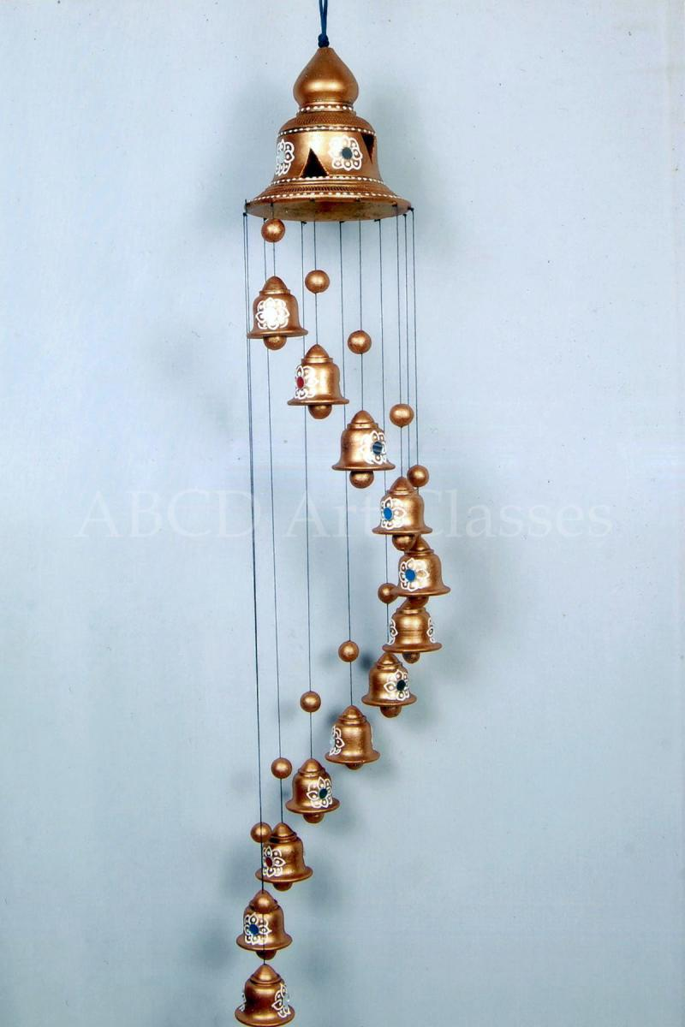
Element 1: TYRE SOUND CHIMES & SWINGS
These are safe and fun for kids to walk in between, climb on to and sway and create their own activity around as they will be made with soundful tyres.

Slide 5
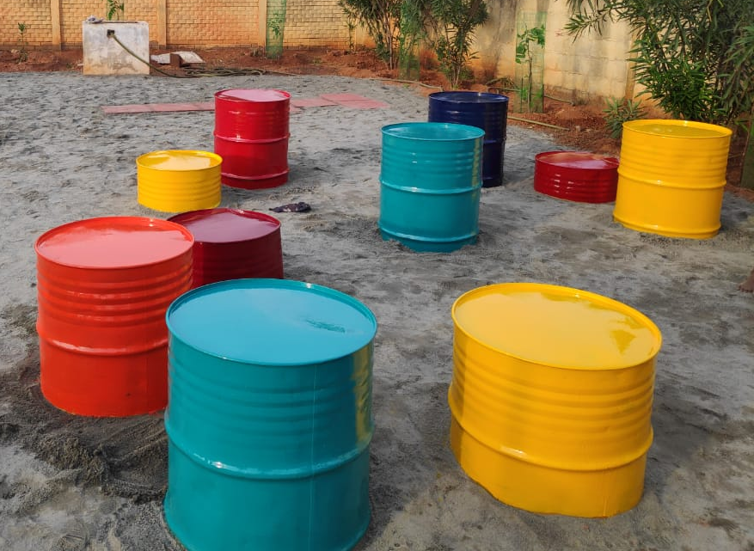
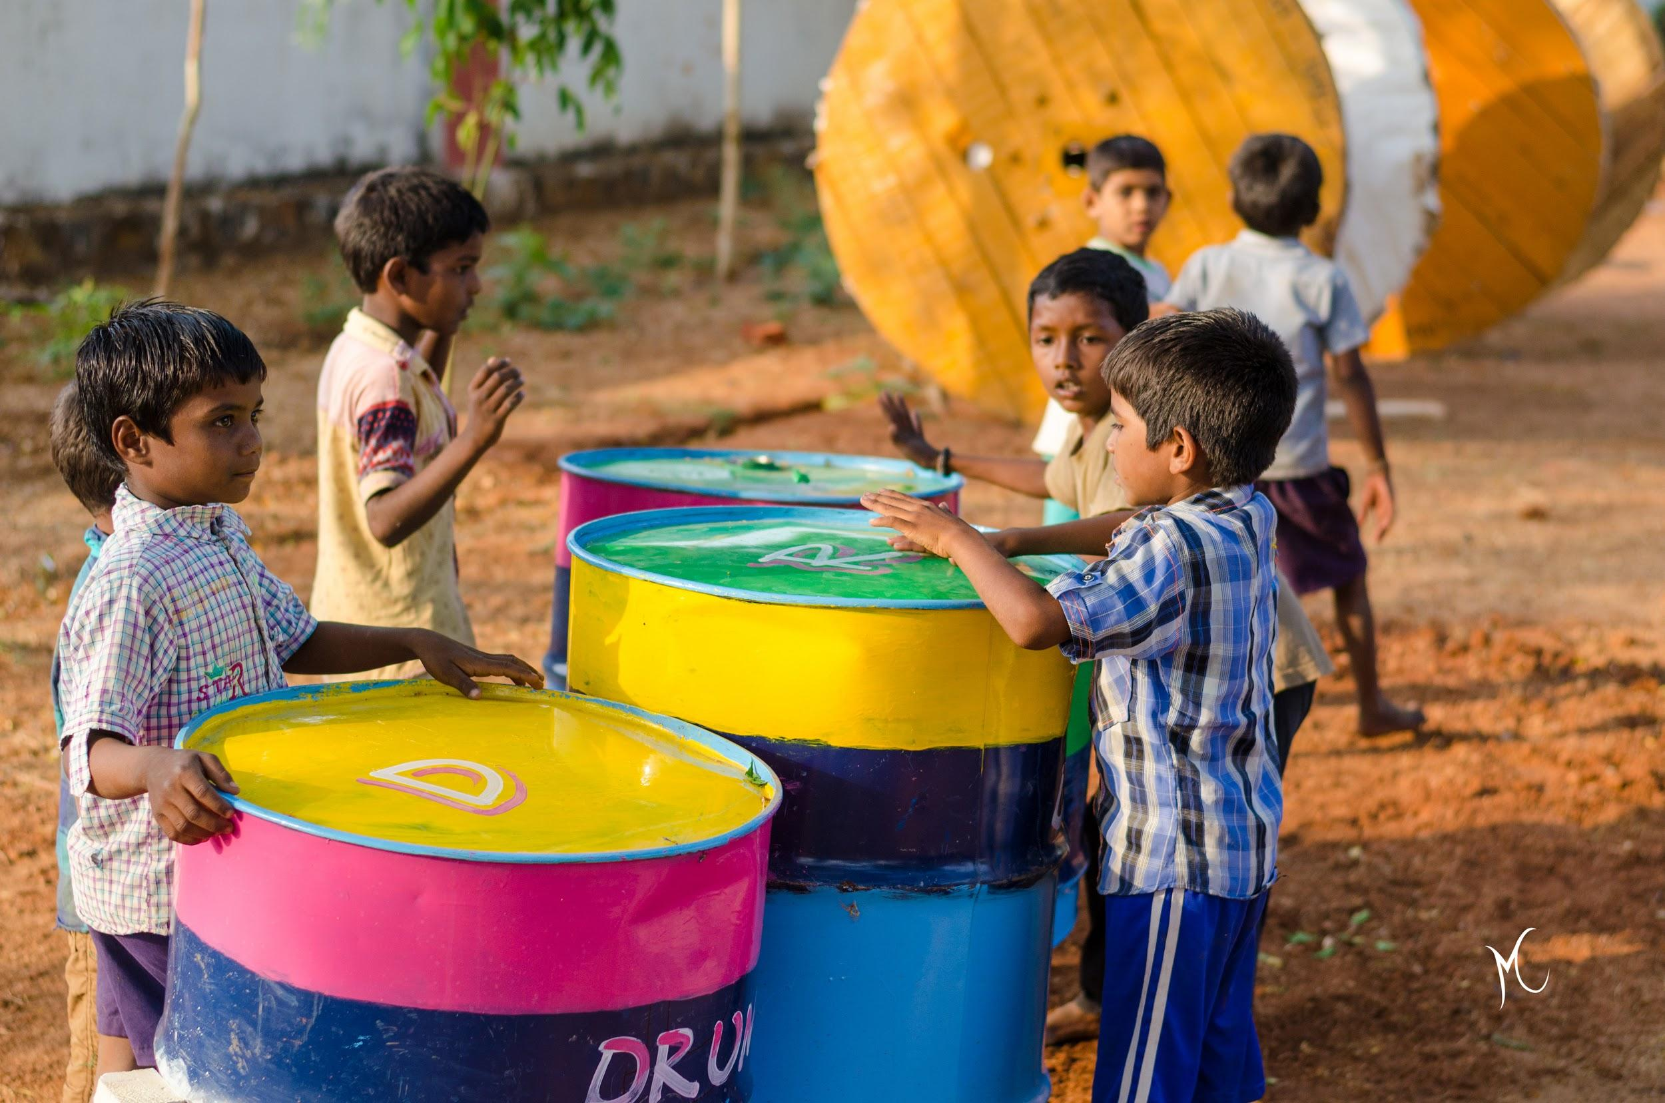
element 3: drumming set
Children love to make sounds and play with structures which are dynamic in nature.
We will use 8 oil drums/ paint tins of varying sizes that would produce different sounds.

Slide 6
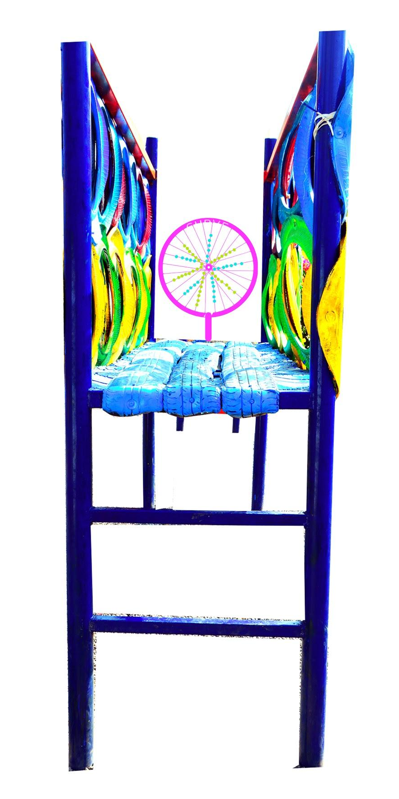
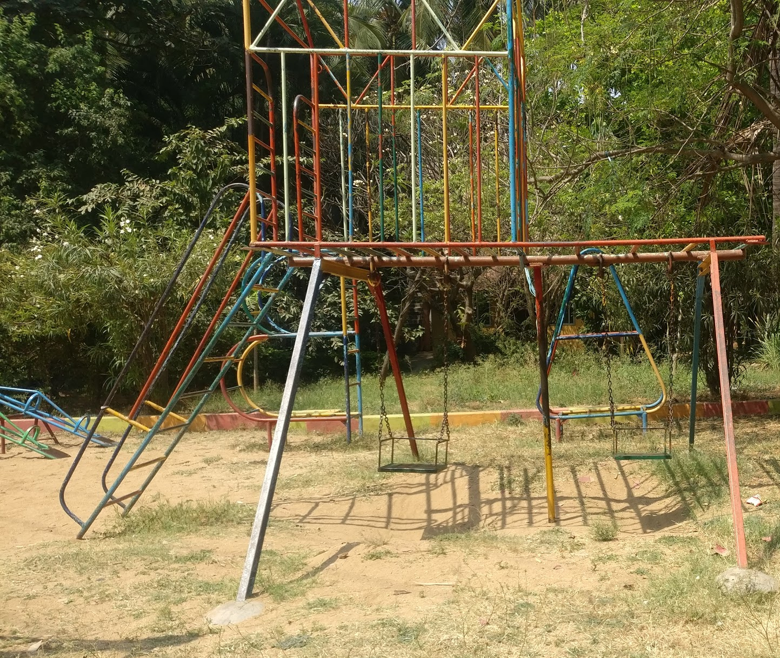

element 6: BRIDGE TO NEON RIMS
The sides of the setup have no finish point, thus these neon spinning rims with beads and countables would be exciting and inviting for the children.
MODIFYING

Slide 7
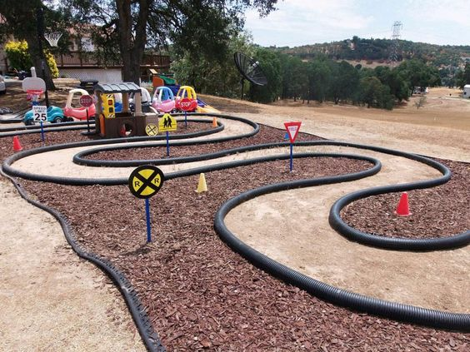
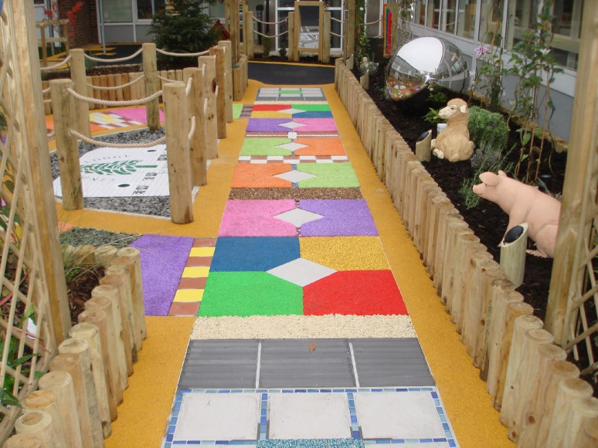
element 4: TEXTURES WALKWAYS
The sense of touch and the feel of different textures will help them easily map the playground, thus we wish to unify the entire playscape with the help of textured pathways and 3d sign boards

Slide 8
element 4: TEXTURES WALKWAYS
The sense of touch and the feel of different textures will help them easily map the playground, thus we wish to unify the entire playscape with the help of textured pathways and 3d sign boards

Slide 9
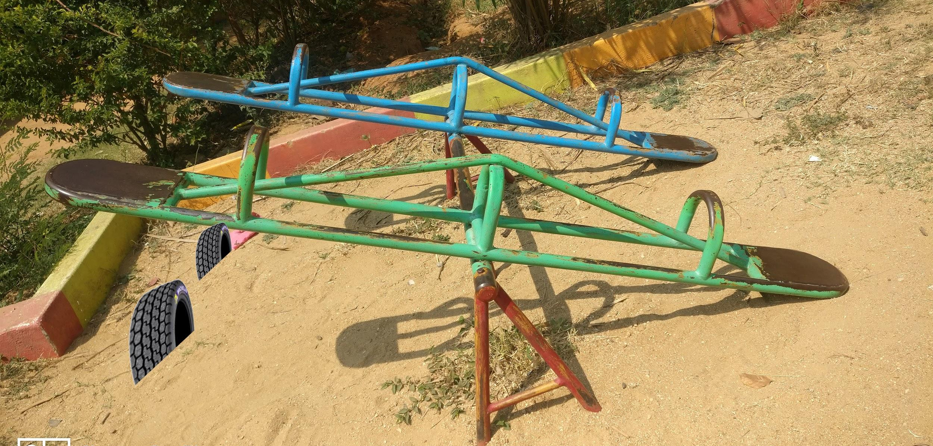
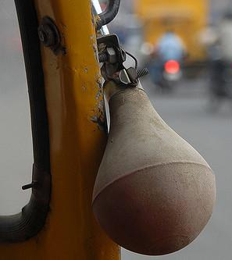
element 5: HONKING SEESAW
noisy tyre
auto horn, the noise element
The seesaw would be modified to be safe and fun for the children. The tyres in the ground right below the 4 seats will make it shock proof and the horn will make it noisy for children to enjoy a lot more on the seesaw.

